Slide 1
Interrupts
The PIC16F627A/628A/648A has 10 sources of interrupt:
• External Interrupt RB0/INT *
• TMR0 Overflow Interrupt *
• PORTB Change Interrupts (pins RB<7:4>) *
• Comparator Interrupt
• USART Interrupt TX
• USART Interrupt RX
• CCP Interrupt
• TMR1 Overflow Interrupt *
• TMR2 Match Interrupt *
• Data EEPROM Interrupt

Slide 2
Interrupts
IMPORTANT!!! We need to access two different registers: INTCON and OPTION. INTCON is in bank 0, OPTION is in bank 1

Slide 3
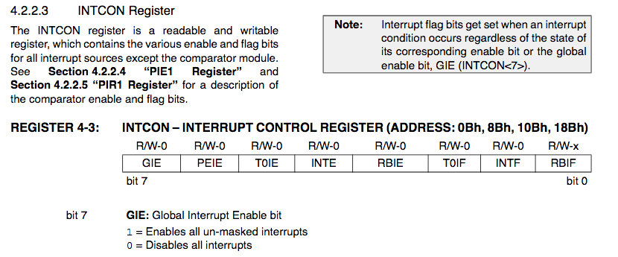
Interrupts to enable interrupts: bsf INTCON,GIE or bsf INTCON,7

Slide 4
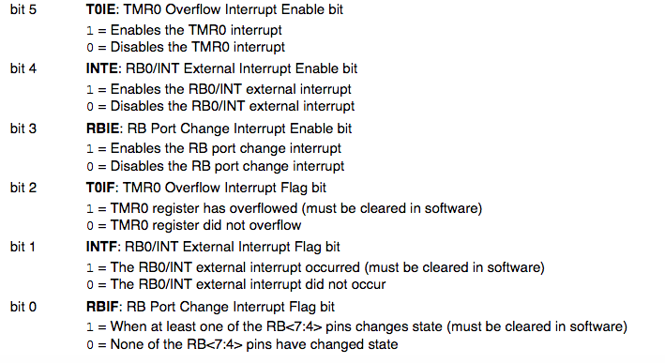
Interrupts: let’s focus on local interrupts TMR0- Timer 0 alarm has gone off B0 – change on pin B0 RB PORT Change- change on one of B4,B5,B6,B7

Slide 5
Interrupts Suppose we wish to interrupt on : - change on B0 - when TMR0 alarms sounds
bsf INTCON, GIE ; enable global interrupts
bsf INTCON,INTE ; enable change of B0 interrupt
bsf INTCON,TMIE ; enable Timer 0 interrupt

Slide 6
Interrupts
Each local interrupt enable bit has a corresponding flag bit. The flag indicates that this type of interrupt has occurred:
INTE→INTF (B0 change )
TOIE→TOIF (Timer0 alarm)
RBIE→RBIF (change on B4,B5,B6, or B7)

Slide 7
Interrupts: INTE versus RBIE
INTE occurs with a change on B0. The programmer decides if the desired interrupt change is from low to high or high to low. This is specified in the OPTION register bit 6 (INTEDG)
RBIE occurs with any change of state on pins B4,B5,B6,B7

Slide 8
Interrupts
Let’s set an interrupt on B0 on a rising edge:
bsf INTCON,GIE ; enable global interrupts
bsf INTCON,INTE ; enable B0 interrupt
bsf STATUS,RP0 ; goto bank 1 movlw 0x01 movwf TRISB ; portb pin 0 is input
bsf OPTION, INTEDG ; interrupt on low to high bcf STATUS,RP0 ; ;return to bank 0

Slide 9
Interrupts
Interrupt Service Routines (ISR) always end with retfie
When an interrupt occurs, the GIE is set to 0. Thus, an interrupt cannot occur while an interrupt is occurring.
retfie re-enables GIE
Interrupts do “stack”. That is, if an interrupt occurs while an interrupt is being serviced, the new interrupt will be serviced after the older interrupt finishes and retfie re-enables interrupts
When an interrupt occurs, only the PC is saved on a stack. The programmer must save any other registers (like the W???)
NEVER set or clear GIE in an interrupt routine

Slide 10
Timer 0
Timer 0 (TMR0) is an 8-bit register in bank 0
TMR0 will set the Timer 0 flag (T0IF) on overflow from 0xff to 0x00
T0IF will be set even if interrupts are not enabled (true for all interrupt flags)
TMR0 will “tick” either from the system clock or from transitions externally (pin A4)
We are interested in using Timer 0 with the system clock

Slide 11
Timer 0
Timer 0 users a “prescaler”. Think of the PIC as ticking every 1 microsecond. We can set different prescalers so that Timer 0 increments at a slower pace. Timer 0 has prescalers as follows:
2:1 increment every 2 microseconds
4:1 increment every 4 microseconds
…..
256:1 increment every 256 microseconds
So Timer 0 can actually give time upto 65,536 microseconds. Note, there is no 1:1 prescaler.

Slide 12
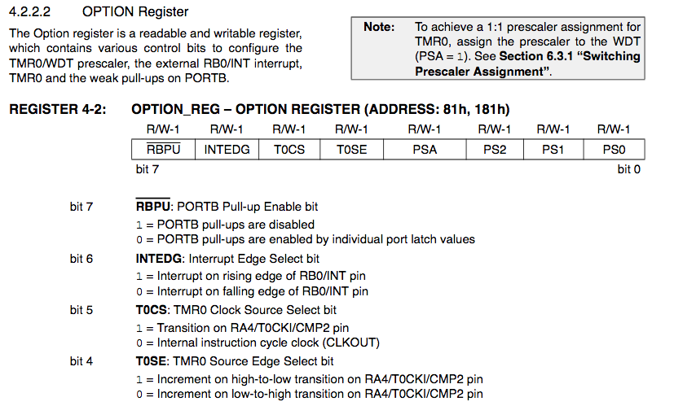
Timer 0: revisit OPTION register (bank 1) bcf OPTION,TOCS ; use internal clock

Slide 13
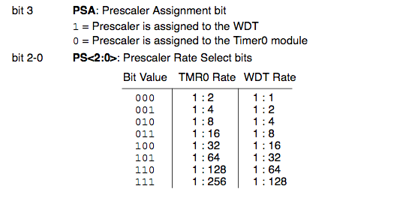
Timer 0 – revisit OPTION register bcf OPTION,PSA ; select Timer0, not watch dog timer bcf OPTION,2 ; next three set prescaler to 2:1 bcf OPTION,1 bcf OPTION,0

Slide 14
Timer 0 – 500 microsecond timer, no interrupt
Let’s see: we’ll need 250 “clicks” of the timer with a 2:1 prescaler. So we will load TMR0 with the value 0x06.
bsf STATUS,RP0 ; goto bank 1
; select system clock (bit 5), TMR0(bit 3), prescaler 2:1( bits 2-0) movlw 0x00 movwf OPTION ; set bits 5,3,0-2 bcf STATUS,RP0 ;return to bank 0
movlw 0x06
movwf TMR0 ; place a 6 in timer
btfss INTCON,T0IF ; overflow?
goto $-1

Slide 15
Timer 0 – generate an interrupt in 500 microseconds (set up is in main)
bsf INTCON,GIE ; enable global interrupts
bsf INTCON,T0IE ; enable Timer 0 interrupt
bsf STATUS,RP0 ; goto bank 1 movlw 0x00 ; system clock, timer 0, 2:1 prescaler movwf OPTION ; portb pin 0 is input bcf STATUS,RP0 ; ;return to bank 0
movlw 0x06
movwf TMR0
Blah blah blah ; go on your merry way, interrupt in 500 micros

Slide 16
Coding it
main must reside at 0x00 and ISR must reside at 0x04. Typical layout:
org 0x00
goto main
org 0x04
goto isr
isr
…...
......
retfie
main
......
......
end

Slide 17
Coding it
An interrupt clears GIE, retfie resets it. Leave it alone!!
An interrupt sets the specific interrupt flag. You must clear it before you execute retfie. Otherwise, the interrupt will never occur again.
If you have enabled several interrupts, your interrupt routine must poll the interrupt flags to determine which interrupts occurred. You may service multiple interrupts in a routine. If you don’t, the subsequent interrupts will be triggered immediately upon executing a retfie.

